Slide 1

Checklst.
Location Based Reminder App
Under the guidance of : Prof. Rajkumar Shende

Slide 2




Group members
Rebecca Dias 182027
Roll no: 19
Chelsea Dsouza 182031
Roll no: 24
Delicia Fernandes 182035
Roll no: 28
Bhoomika Mewada 182068
Roll no: 60

Slide 3
COntents
Introduction
Problem Definition
Implementation
Observation
Conclusion

Slide 4

introduction
A location based reminder app with Cloud functionality so that any user can access it on multiple devices.
Add, Delete & cross off reminders according to their convenience and can also view the list of reminders within the application.
The User can set their reminders on any day and time that they prefer based on a location or time, and the application will display their reminder when they reach a particular location or at the desired time.
The user then receives a Push notification on the mobile device!

Slide 5
Problem Definition
For awhile now, the world was closed off due to the pandemic which meant everyone was “Working from home”
Managing things at home and work can become difficult for anyone
Remembering what to do when can itself become a task
To ease this transition, Checklst app to our rescue
Your helpful buddy keeping track of daily jobs at your convenience to help you complete tasks quickly & efficiently.

Slide 6


implementation
The technologies we used for the application are:
FLUTTER
FIREBASE
Notes:
Flutter is Google’s UI toolkit for building natively compiled cross platform applications for mobile, web, and desktop from a single codebase. Using dart as the programming language
The Firebase Realtime Database is a cloud-hosted NoSQL database that lets you store and sync data between your users in real time.

Slide 7
implementation
User friendly UX/UI
Location-based GPS
The android app stores the GPS location coordinates of the ‘reminder’ and upon reaching near the location, a push notification is sent to the user as a reminder and displays location on map.
User Authentication
This is done using user profiles, which uses users’ google profile to log into the device and keep track.
Add / Delete / Check off reminder note
The app privileges the user to add, update or delete a ‘reminder’ based on time or location.
Database storage
User profiles are connected using google sign in method to secure the profile data and the remainder data including note, date-timing and location-coordinates is stored in database created in Firebase
Notes:
Four objective fulfulled
1 The android app is made with minimal GUI components and ease-access interface for lucidity in the application.
Location based gps - geocoder package
# Google Services:
firebase_core: ^0.5.2+1
firebase_auth: ^0.18.3+1
cloud_firestore: ^0.14.3+1
provider: ^4.3.2+2
google_maps_flutter: ^1.0.6

Slide 8
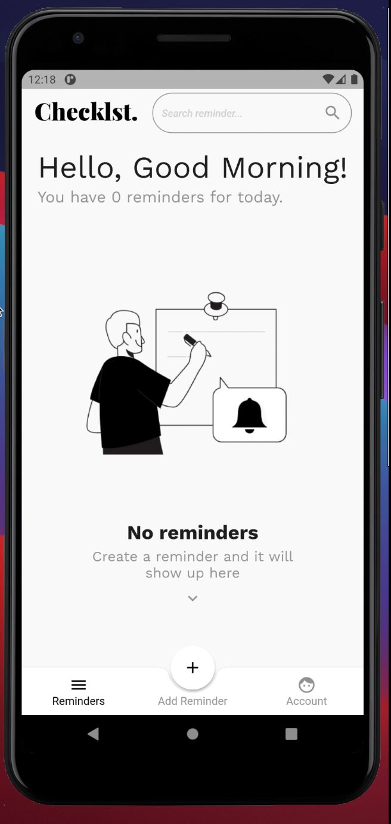
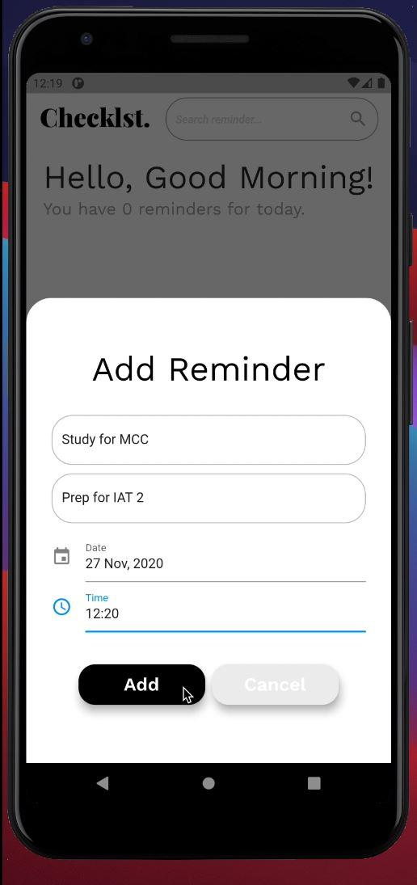
OBSERVATIONS

Slide 9

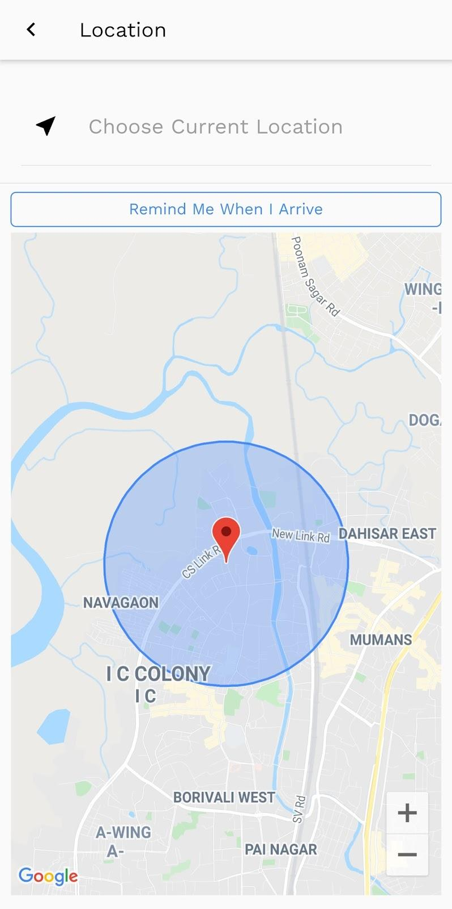
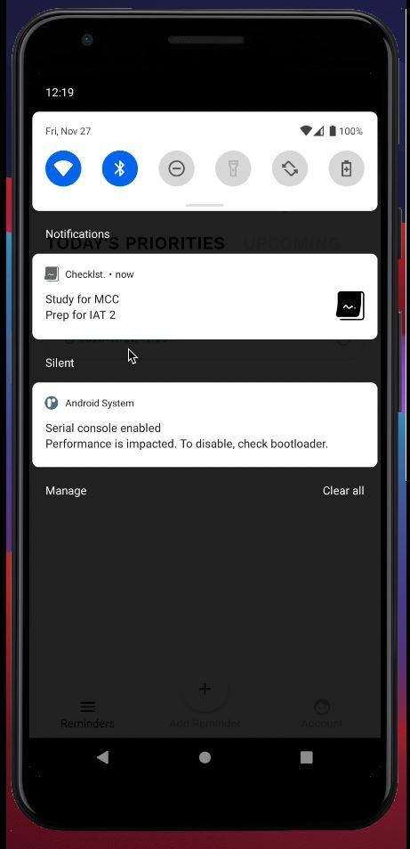
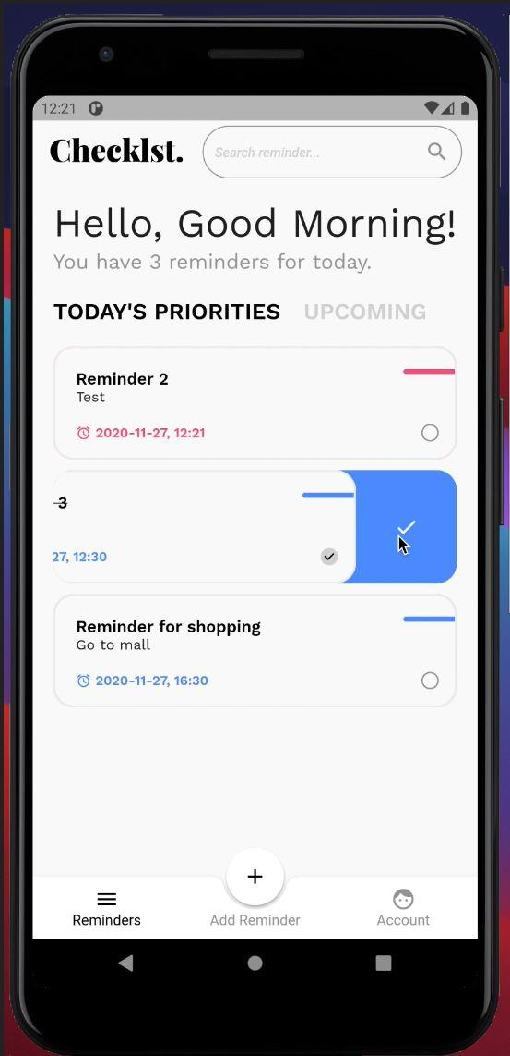
observations

Slide 10
conclusion
Hence, we created an android application for location-time based reminder in Flutter using Firebase as the database for easy and secure access to our database.
The application has user-friendly interface, and additional feature of GPS location, which makes it different from the traditional reminder apps. The app works successfully!

Slide 11
Thank you!
Rebecca Dias
Chelsea Dsouza
Delicia Fernandes
Bhoomika Mewada

